Slide 1
Quick Guide:
PSR04 Smart Color Button
Philio Technology Corporation
EASYFIKS SMART HOME

Slide 2
Contents
I、 How to Use
II、 Include Device
III、 Exclude Device
IV 、 Sensor Settings
1. Change Device Name
2. Delete Log

Slide 3
Contents
V、 Room Settings
1. Change room image
2. Move to a different room
VI 、 Scene
1. Intruder Alarm
VII 、 Marco
VIII、 Schedule

Slide 4
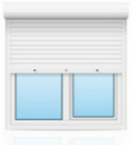
How to Use

Slide 5
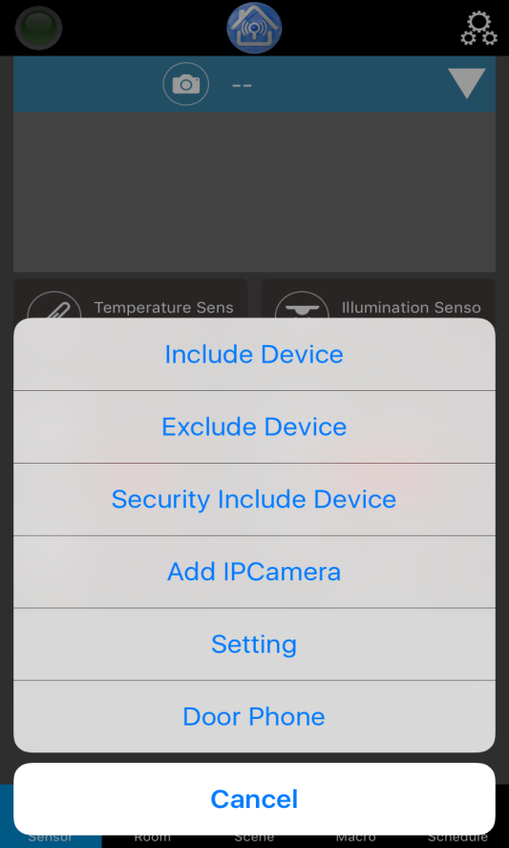
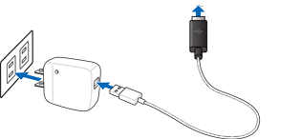
Include Device
1. Plug the USB adaptor into the outlet and plug micro USB connector to the PSR04 then power on the device.
3.While device is in auto inclusion mode, click on the setting icon and select “Include Device”.
2. The red light LED is flashing, unplug the micro USB connector and the device is in auto inclusion mode.

Slide 6
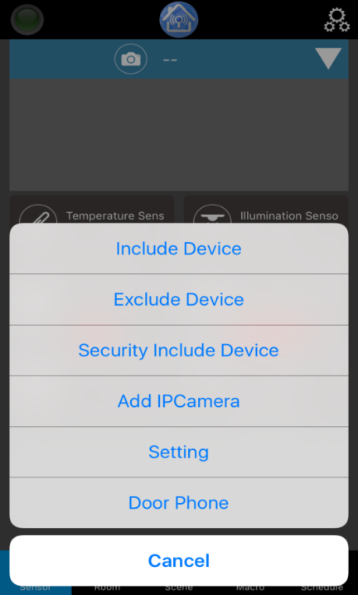
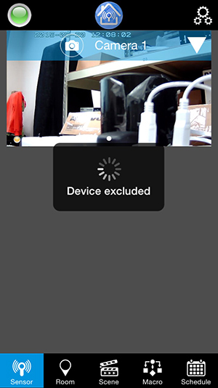
Exclude Device
1. Click on the setting icon and select “Exclude Device”.
2. Make sure the PSR04 is on horizontal, the dot is facing down and the White LED will flash then press 3 times to exclude from the network.
3. Device is excluded from the network and back to the auto inclusion mode (the red light LED will flash).

Slide 7
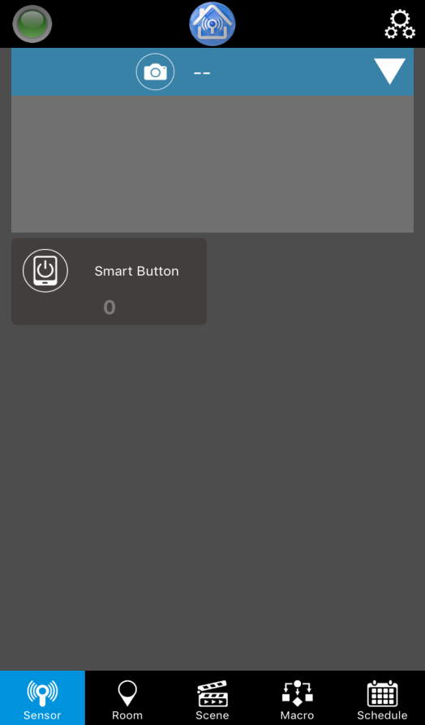
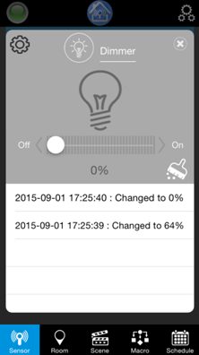
Sensor Settings
1. Click on the device that you want to see the status of device.
2. A new window will open with the device information.

Slide 8
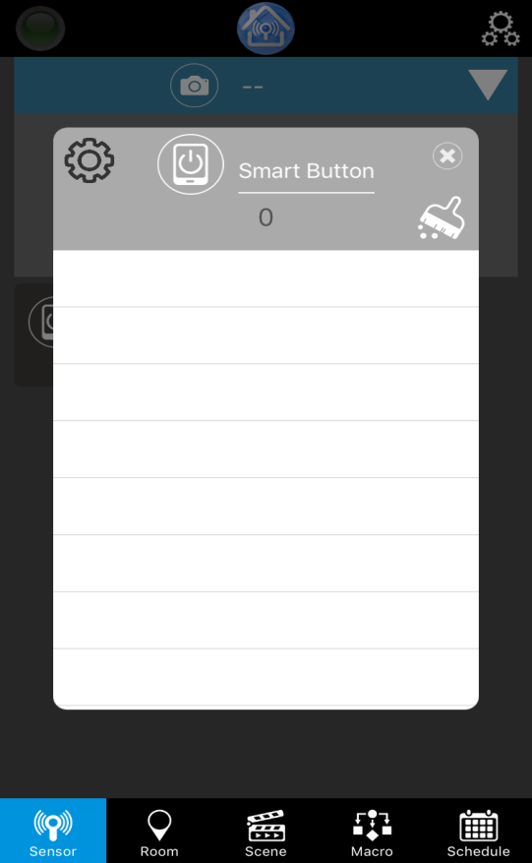
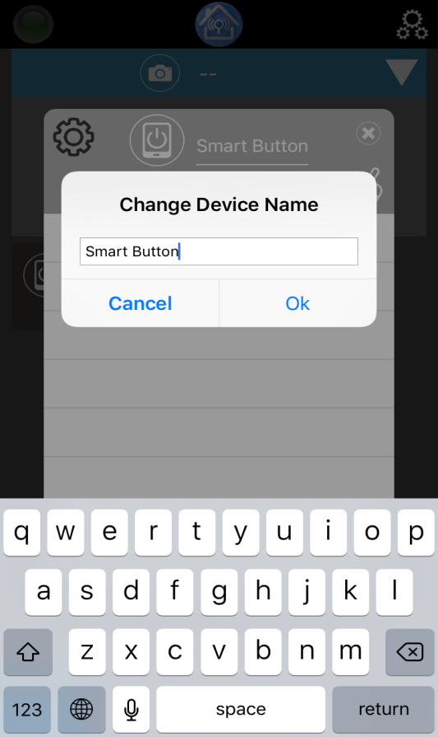
Sensor Settings
Change Device Name
1. Click on the name of the device.
2. Change the name of the device and click OK.

Slide 9
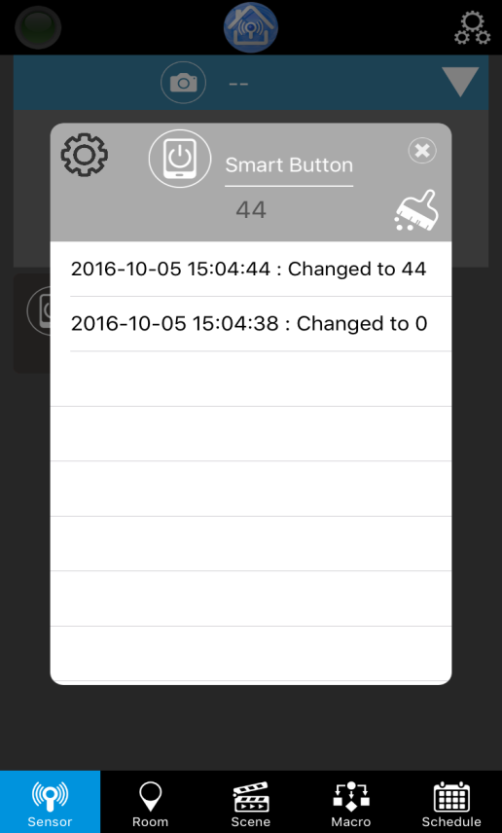
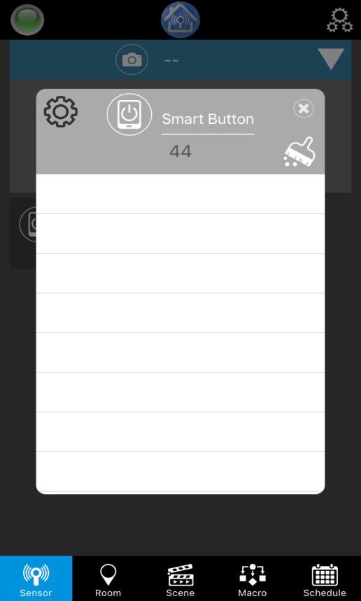
Sensor Settings
Delete Log
1. To delete log, click on the brush tool.
2. Once clicked, all logs will be removed.

Slide 10
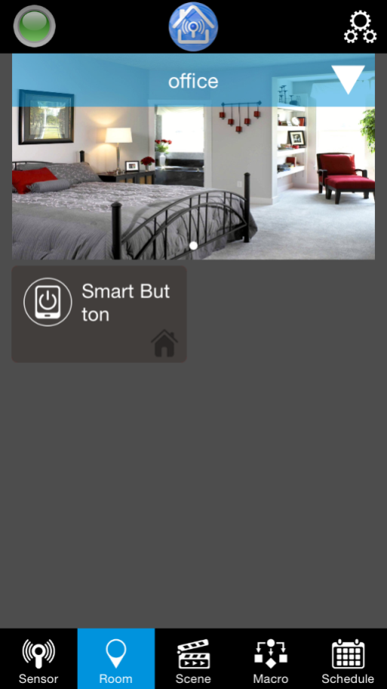
Room Settings
The room settings must create vie Tablet/Pad/Advance Settings (web user manual).
When a Room is created, the selected devices are located in the Room.

Slide 11
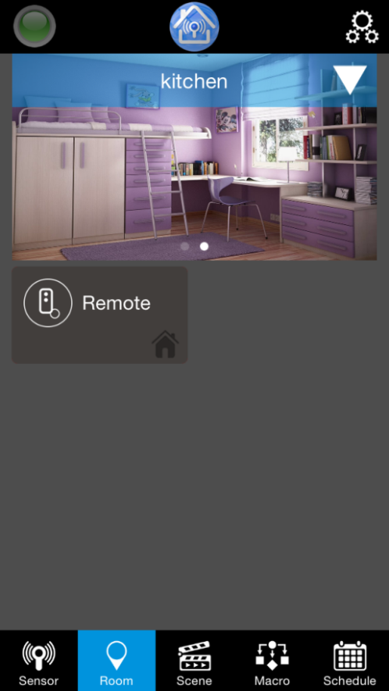
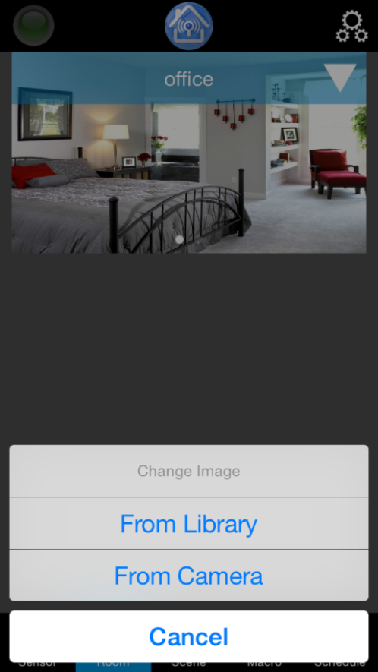
Room Settings
Change Room image
2. You can opt to choose an image from Library or from Camera.
1. Click on the image.
Note: Images are done locally, so any image change done in room will only remain on that devices.

Slide 12
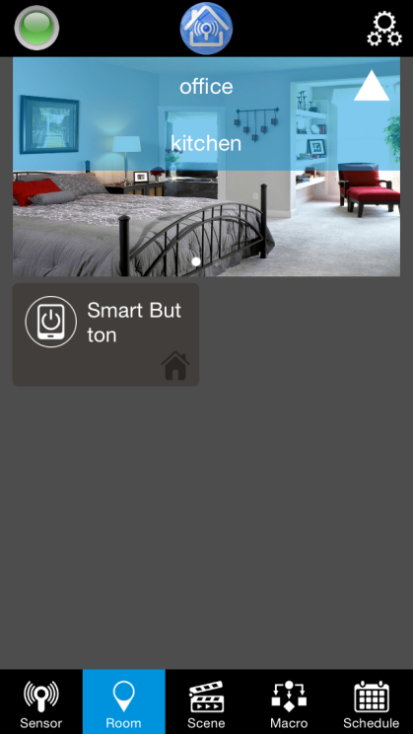
Room
Move to a different Room
1. Select the down arrow on the upper right side.
2. Select the room you want to view.
3. It will show the sensors on the selected room.

Slide 13
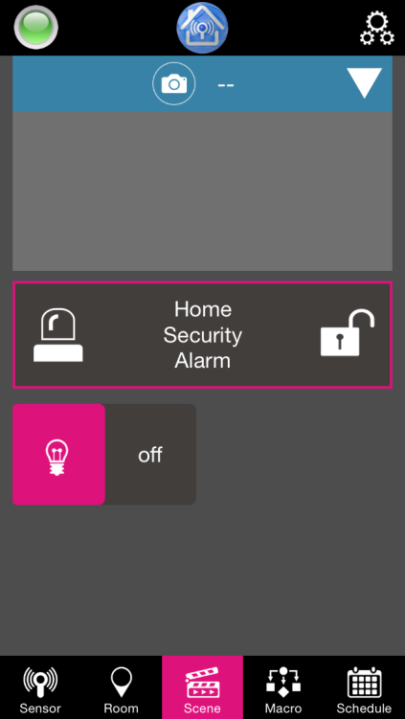
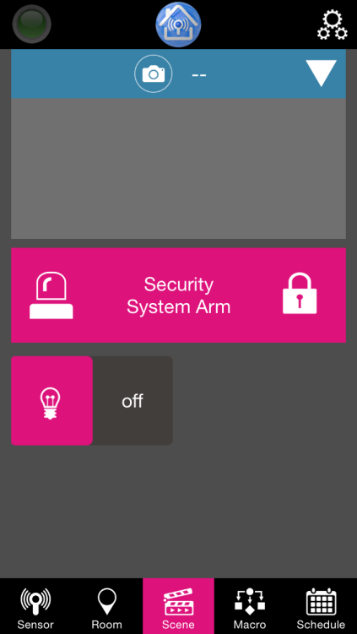
Scene
Intruder Alarm
To activate armed and disarmed mode, click the lock.
During armed mode, the padlock icon will be close, and the box will be in pink.

Slide 14
Macro
The Macro settings must create vie Tablet/Pad/Advance Settings (web user manual).
When a Marco is created, you can activate or deactivate the Marco.

Slide 15
Schedule
The schedule settings must create vie Tablet/Pad/Advance Settings (web user manual).
When a Schedule is created, you can activate or deactivate the Schedule.

Slide 16
EASYFIKS SMART HOME
Notes:
16
16

